Slide 1
LEI 21-22 S4 2DC_3​
PROGRESS – SPRINT C
29 MAY 2022
Bárbara Pinto 1191507 | ​Carlos Dias 1200991​ | Cristóvão Sampaio 1201029 | ​ Miguel Silva 1201045​ | Martim Maciel 1201154

Slide 2
SUMMARY – Project Phases
WEEK 1
Technical Review Implementation
Project Review
WEEK 2
Development of Server communications and respective protocol
Development of grammar for validating Questionnaires
WEEK 3
Development of remaining functionalities

Slide 3
PLANNING - PROJECT
1

Slide 4
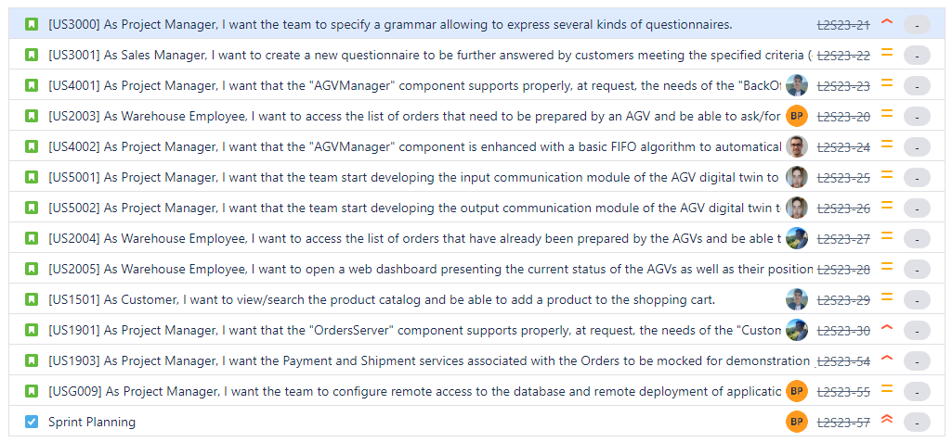

Slide 5
CONCLUDED ACTIVITIES – PROJECT MANAGEMENT
US​ | Description​ | Assignee​ | Baseline​ | Actual​ | Status​
USG009 | As Project Manager, I want the team to configure remote access to the database and remote deployment of application. | Carlos Dias | Start: 8 May 2022 End: 15 May 2022 | Start: 13 May 2022 End: 13 May 2022 | ✔️
US1901 | As Project Manager, I want that the "OrdersServer" component supports properly, at request, the needs of the "CustomerApp" application. | Martim Maciel | Start: ​15 May 2022 End: 22 May 2022 | Start: ​23 May 2022 End: 29 May 2022 | ✔️
US1903 | As Project Manager, I want the Payment and Shipment services associated with the Orders to be mocked for demonstration purposes. | Bárbara Pinto | Start: 8 May 2022 End: 15 May 2022 | Start: ​16 May 2022 End: 26 May 2022 | ✔️
US5002 | As Project Manager, I want that the team start developing the output communication module of the AGV digital twin to update its status on the "AGVManager". | Carlos Dias | Start: 15 May 2022 End: 22 May 2022 | Start: ​17 May 2022 End: 25 May 2022 | ✔️
US5001 | As Project Manager, I want that the team start developing the input communication module of the AGV digital twin to accept requests from the "AGVManager". | Carlos Dias | Start: 15 May 2022 End: 22 May 2022 | Start: 17 May 2022 End: 25 May 2022 | ✔️
US4001 | As Project Manager, I want that the "AGVManager" component supports properly, at request, the needs of the "BackOfficeApp" application as well as the needs the AGV digital twin. | Miguel Silva | Start: 15 May 2022 End: 22 May 2022 | Start: 23 May 2022 ​ End: 29 May 2022 | ✔️
US3000 | As Project Manager, I want the team to specify a grammar allowing to express several kinds of questionnaires. | All team members | Start: 15 May 2022 End: 22 May 2022 | Start: ​25 May 2022 End: 29 May 2022 | ✔️

Slide 6
CONCLUDED ACTIVITIES – PROJECT IMPLEMENTATION
US​ | Description​ | Assignee​ | Baseline​ | Actual​ | Status​
US1501 | As Customer, I want to view/search the product catalog and be able to add a product to the shopping cart. | Miguel Silva | Start: ​22 May 2022 End: 29 May 2022 | Start: ​19 May 2022 End: 28 May 2022 | ✔️
US2005 | As Warehouse Employee, I want to open a web dashboard presenting the current status of the AGVs as well as their position in the warehouse layout and keeps updated automatically (e.g.: at each minute). | Bárbara Pinto | Start: ​22 May 2022 End: 29 May 2022 | Start: ​24 May 2022 End: 29 May 2022 | ✔️
 |  | Cristóvão Sampaio
US2004 | As Warehouse Employee, I want to access the list of orders that have already been prepared by the AGVs and be able to update any of those orders as having been dispatched for customer delivery. | Martim Maciel | Start: ​22 May 2022 End: 29 May 2022 | Start: ​26 May 2022 End: 28 May 2022 | ✔️
US4002 | As Project Manager, I want that the "AGVManager" component is enhanced with a basic FIFO algorithm to automatically assign tasks to AGVs. | Cristóvão Sampaio | Start: ​22 May 2022 End: 29 May 2022 | Start: ​28 May 2022 End: 29 May 2022 | ✔️
US2003 | As Warehouse Employee, I want to access the list of orders that need to be prepared by an AGV and be able to ask/force any of those orders to be immediately prepared by an AGV available. | Bárbara Pinto | Start: ​22 May 2022 End: 29 May 2022 | Start: ​28 May 2022 End: 29 May 2022 | ✔️
US3001 | As Sales Manager, I want to create a new questionnaire to be further answered by customers meeting the specified criteria (e.g.: have ordered a given product; belong to a given age group). | All team members | Start: ​22 May 2022 End: 29 May 2022 | Start: ​19 May 2022 End: 29 May 2022 | ✔️

Slide 7
SYSTEM AND PRODUCT DELIVERY
SYSTEM OBJECTIVES
Provide protocol communication between application and develop existing functionalities:
» Add products to shopping cart
» Assign tasks to AGVs​
» Dispatch orders
» Validate customer surveys​
Guarantee data persistence (in-memory and on a local/online database)​
Provide initialization data to demonstrate system functionalities​
PRODUCT QUALITY
Quality metrics:
» 76% Class coverage ✔️
» 71% Method coverage ✔️
» 70% Class coverage ✔️
Stable build:
» runs outside development environment (IDE)
» runs in remote machines and multiple OS​
Achievements:
» Running servers independently
» Client-server communication implemented with success
​

Slide 8


TEAM WORK AND PLANNING
DEVELOPMENT PROCESS AND PLANNING
» Scrum/Agile methodology​
» JIRA software for task and sprint management​
» Planning based on priority (for time allocation) and user story complexity (for team member allocation)​
TEAM WORK AND CONFLICT SOLVING
» Team daily communication through Discord server and dedicated channels​
» Weekly sprint status reports during LAPR4 PL classes​
» The team considers the sprint was tight on development time but the communication was effective​ and the team members were very cooperative.
​

Slide 9
LEI 21-22 S4 2DC_3​
PROGRESS – SPRINT C
29 MAY 2022
Bárbara Pinto 1191507 | ​Carlos Dias 1200991​ | Cristóvão Sampaio 1201029 | ​ Miguel Silva 1201045​ | Martim Maciel 1201154

